Slide 1
NUMBER OF TRANSACTIONS FROM 2018 TO 2019.
(customer trends and behavior.)

Slide 2
Table of contents.
Exploratory data analysis(EDA).
Univariate Analysis.(continuous data)
Bar chart.(categorical data)
Bivariate Analysis.
Splitting data.
Building model(Baseline).
Evaluate
Recommended product strategy

Slide 3
Exploratory data analysis(EDA).
We note that there’re 23 observations with 8 features.
We also note that there's a missing transaction in the month of may 2018..
Notibly,most transactions happen on debit cards , credit cards, prepaid cards and charge cards, in a chronological order starting with most transactions to the least.

Slide 4
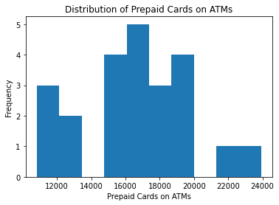
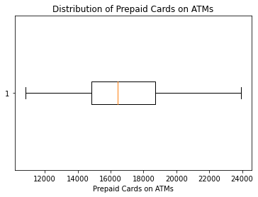
Univariate Analysis. (prepaid cards)
Number of transactions of prepaid cards on Atms are mostly between 15000 and 20000.
There're no outliers and the mean is around 16500.

Slide 5
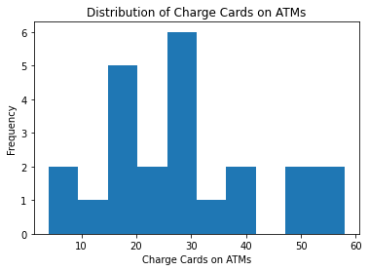
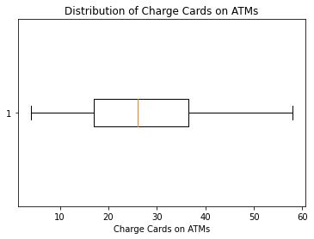
Charge cards
Charge cards are almost a normal distribution on ATMs.
There're no outliers and the mean is around 28.

Slide 6
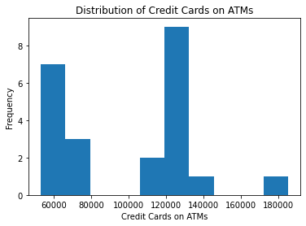
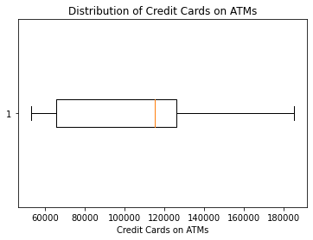
Credit cards
Number of transactions of credit cards on Atms are mostly between ,50000 and 80000, 110000 and 150000.
There're no outliers and the mean is around 120000

Slide 7
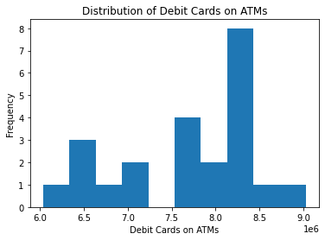
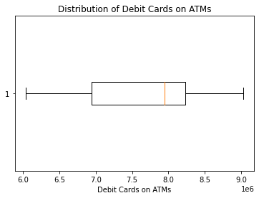
Debit cards
Number of transactions of Debit cards on Atms are mostly between ,6m and 7.2m, 7.5m and 9m.
There're no outliers and the mean is around 7.8m.

Slide 8
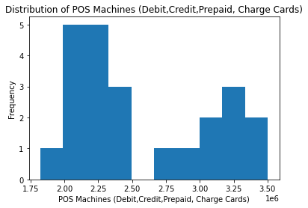
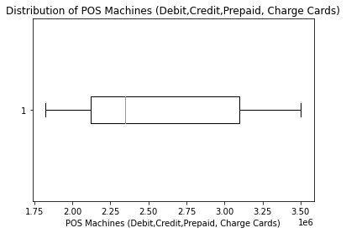
POS Machines.
Number of transactions of PosMachines on Atms are mostly between ,1.8m and 2.5m, 2.7m and 3.5m.
There're no outliers and the mean is around 2.35m.

Slide 9
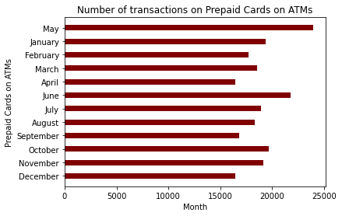
Bar chart. (prepaid cards)
prepaid cards have the highest transactions on may and June and least number of transactions on April and September.

Slide 10
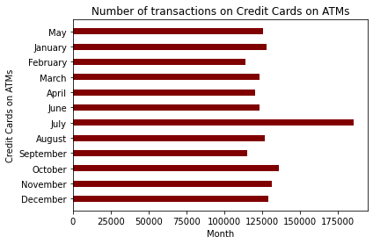
Credit cards
Credit cards have the highest transactions on july and least number of transactions on Feb and September.

Slide 11
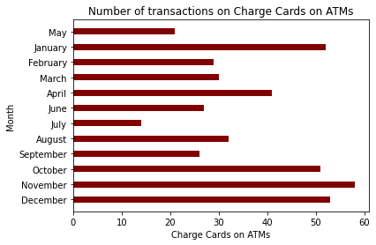
Charge cards
Charge cards have the highest transactions on january and october to december and least number of transactions on may and july based on 2018-2019 data.

Slide 12
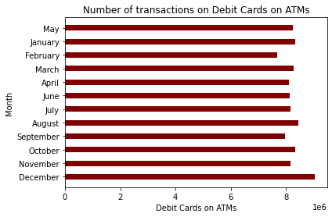
Debit cards
Debit cards have the highest transactions through out the year.

Slide 13
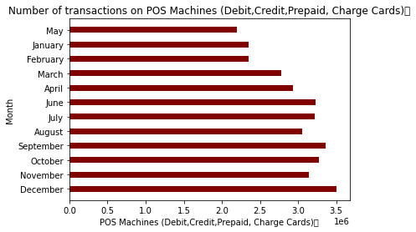
POS Machines
POS Machines (Debit,Credit,Prepaid, Charge Cards) Number of transactions increases through out the 2018-2019 period.

Slide 14
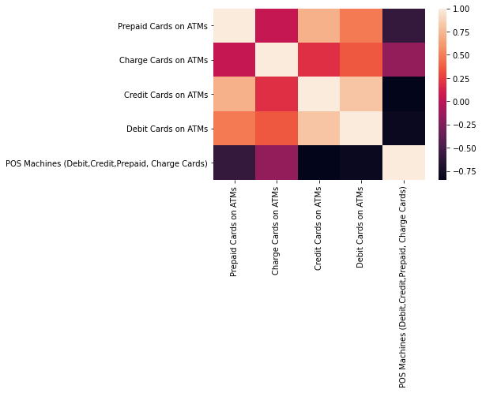
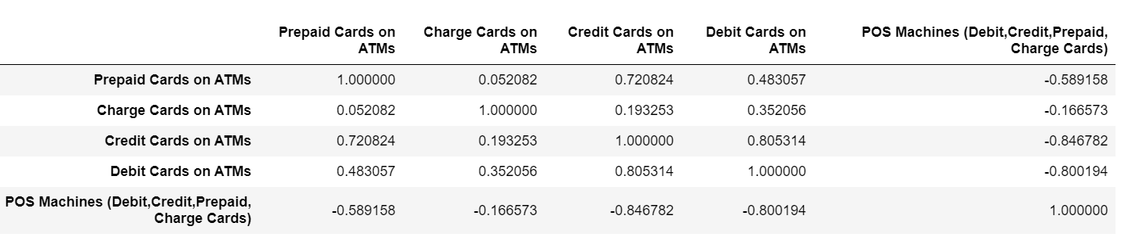
Bivariate Analysis

Slide 15
Splitting data
we note that there's a high -ve correlation between debit,credit with pos machines
Inorder to prevent data leakage we're going to drop the credit charge cards features.
Split X and y into training and test sets. The first 80% of the data should be in your training set. The remaining 20% should be in the test set
Assert that the training and test dataset length are equal to the length of the dataset.

Slide 16
Building model Baseline
Calculate the baseline mean absolute error for your model.
Instantiate a Linear Regression model named model, and fit it to your training data
Mean pos transactions: 2711061.06 Baseline MAE: 456633.06

Slide 17
Evaluate
Calculate the training and test mean absolute error for your model.
Extract the intercept and coefficient from your model
Training MAE: 189225.66 Test MAE: 376352.21
POS Machines (Debit,Credit,Prepaid, Charge Cards) = 6688669.53 + ([-4.65323807e-01 4.94866534e+03 -3.79778223e+01] * Cards on ATMs)

Slide 18
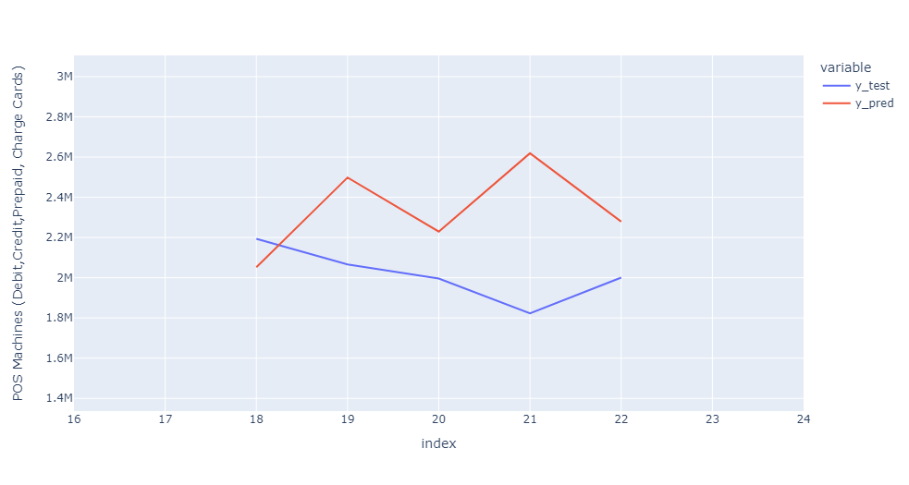
Prediction
First should contain the true values for your test set, and the second should contain your model's predictions.
Time series plot and its prediction of POS Machines (Debit, Prepaid, Charge Cards)
We can note that as time passes the POS machines number of transactions increases.

Slide 19
Recommended product strategy
1. Interswitch should provide more debit cards and Credit cards and produce more debit cards in December and more credit cards in July.
2. We should provide more prepaid cards in May and June and at least in April and September.
3. increase the number of products on credit cards in July.
4. Produce more charge cards in November and January.
5. Produce more POS Machines.

Slide 20
Thankyou

